Slide 1
Crop Recommendations
File created on: 10/08/2023 7:52:41 PM

Slide 2
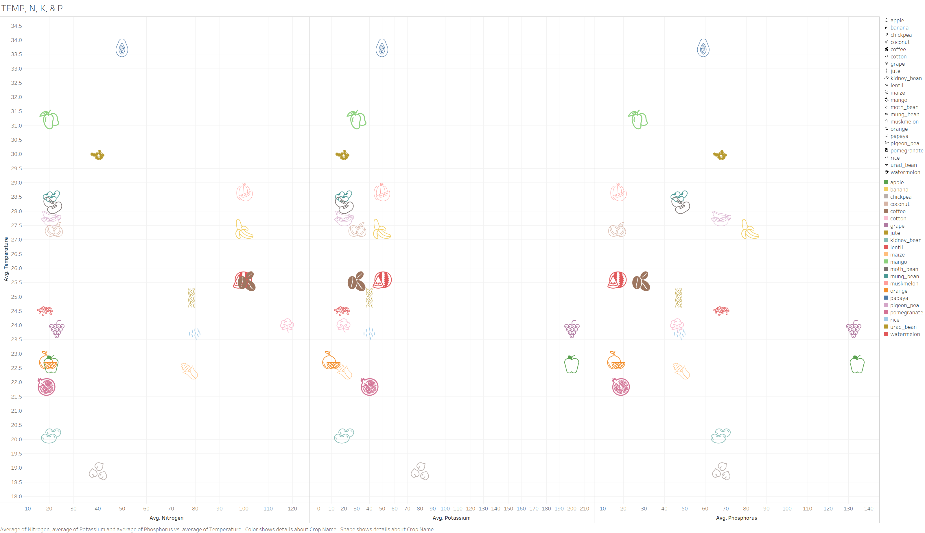

Slide 3
